Slide 1
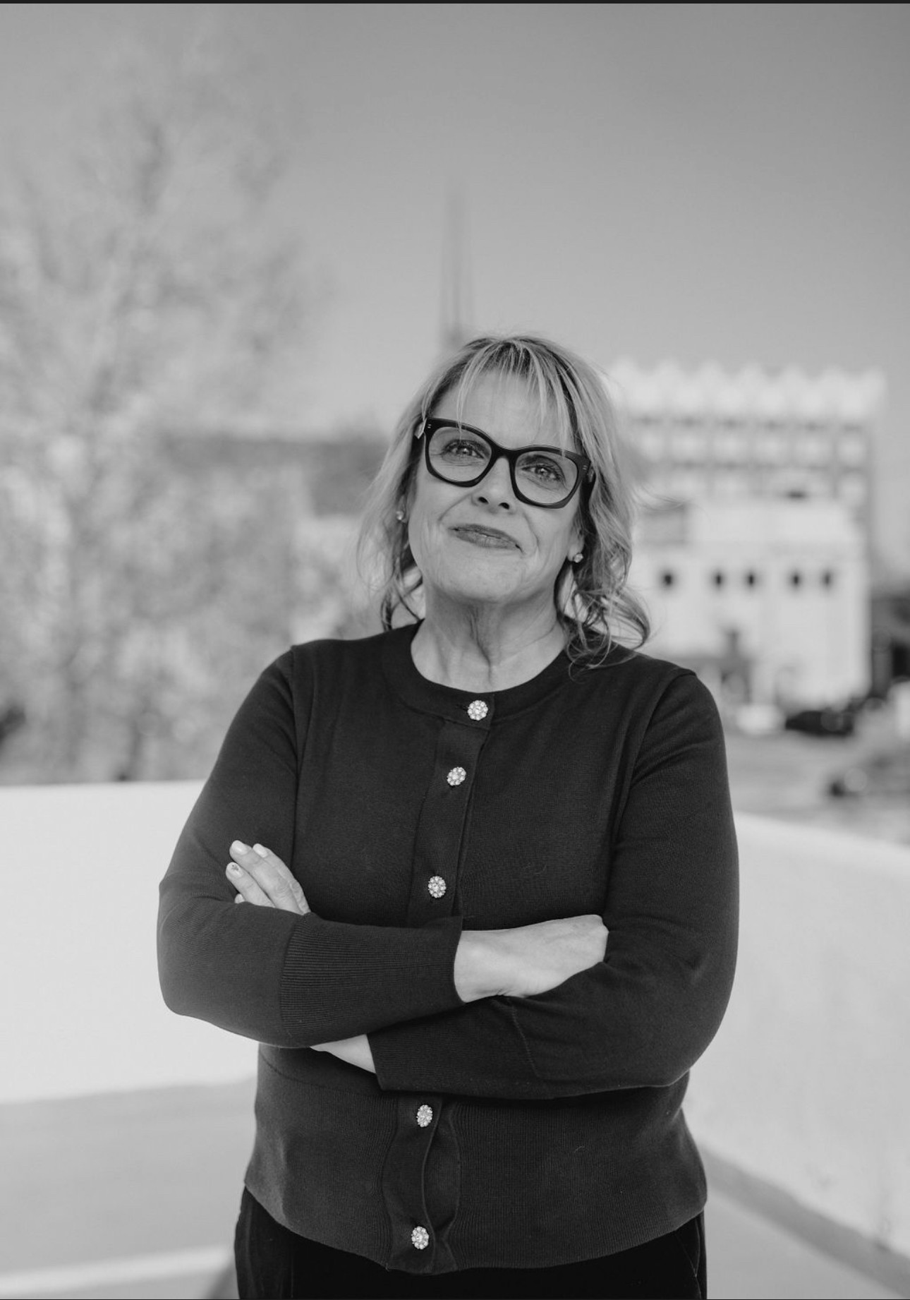

Guardianship 101: *Everything You May Need or Want to Know (or Hope Not to Know) but Were Afraid to Ask
Catherine Z. Welsh
Welsh & McGough, PLLC
https://www.tulsafirm.com/

Slide 2

THANKS TO OUR
MEETING
SPONSOR
September 8, 2025
https://www.youralsok.com/

Slide 3


2025-26 Gold Level Sponsors

Slide 4


2025-26 Gold Level Sponsors

Slide 5


2025-26 Gold Level Sponsors

Slide 6
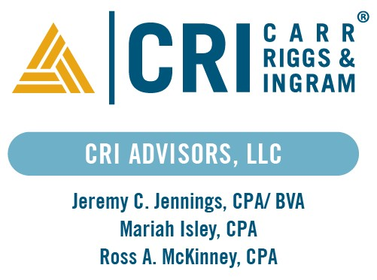

2025-26 Silver Level Sponsors
Lars Gwartney, CFP®, ChFC®, RICP®, CAP®, AEP®
Brian Easlon, CLU®, ChFC®, RICP®

Slide 7




2025-26 Silver Level Sponsors

Slide 8




2025-26 Silver Level Sponsors
Catalyst Financial
Delmer A Dreyer,
CLU®, ChFC®, CLTC, AEP
Charles L. Tefertiller, CPA
Matt Henry, CPA
Jim Ogez, CPA

Slide 9




2025-26 Silver Level Sponsors

