Slide 1

Valuation of the Family LLC and Family Limited Partnership
Jeremy C. Jennings, CPA/ABV
Senior Manager
Management Advisory Services
Sartain Fischbein + Co.
3010 S. Harvard Avenue, Suite 400
Tulsa, OK 74114
Phone: 918.749.6601
www.sfandco.com

Slide 2
Introduction
Overview of the Assets Generally Held by the Entities
  Marketable Securities
  Income Producing Real Estate
  Non-income Producing Real Estate
  Mixed Assets
  Oil and Gas
Background on Applicable Valuation Methods
Asset Approach
Income Approach
  Marketable Securities
  Real Estate
  Mixed Assets
  Oil and Gas
Market Approach
  Marketable Securities
  Real Estate
  Mixed Assets
  Oil and Gas
Valuation Example
The Valuation Report

Slide 3
Introduction
What is a Family LLC (FLLC) or Family Limited Partnership (FLP)?
  Generally, an LLC or FLP with an operating agreement or partnership agreement containing restrictive language with regard to the management of the entity and transfers of ownership

Slide 4
Introduction
Primary Advantages
  Lawsuits – Well suited to protect assets from creditors
  Management – Using one entity to manage multiple assets allows owners to take advantages of economies of scale by reducing management, administrative and professional fees
  Education – The consolidation of assets into one entity can enable senior family members to educate younger family members about family owned investments and how those assets are managed
  Protection – Certain family dynamics sometimes require senior members of families to use trusts and partnerships to protect assets from the possibility of poor decisions
  Gifting Attributes – Senior members of a family can gift interest in the entity while still maintaining control of the entity
  Tax Benefits – When properly formed and transferred, the entity can provide tax benefits in inheritance situations

Slide 5
Assets Generally Held by the Entities
  Marketable Securities
  Income Producing Real Estate
  Non-income Producing Real Estate
  Mixed Assets
  Oil and Gas
  Other

Slide 6
Background on Applicable Valuation Methods
Net Asset Value Method
  Commonly used method historically
  Discounts
    Slap-on Discounts Method
    Discounts taken from studies based on operating entities
    Discounts taken from prior FLLC/FLP tax court cases

Slide 7
Background on Applicable Valuation Methods
Comprehensive Guide for the Valuation of Family Limited Partnerships
  Bruce A. Johnson, ASA, Munroe, Park & Johnson, Inc., Spencer J. Jefferies, Partnership Profiles, Inc., James R. Park, ASA, Munroe, Park & Johnson, Inc.
  Published by Partnership Profiles, Inc., Argyle, Texas
  Now in its 4th Edition
  Discussion of empirical data for use in the Income and Market Approaches when valuing entities holding the type of assets discussed earlier

Slide 8
Background on Applicable Valuation Methods
Comprehensive Guide for the Valuation of Family Limited Partnerships
  Authors contributed to the Family Limited Partnerships section of PPC’s Guide to Business Valuation
  Methods and Empirical Data Sources referenced in various business valuation texts and seminars

Slide 9
Asset Approach
  Generally not appropriate for valuing non-controlling interests
  Applicability of various discounts studies to holding-type entities
  Net Asset Value – Starting point for Income and Market Methods

Slide 10
Income Approach
Based on a fundamental financial theory that value is based on the present value of the expected future benefits of an investment. The future benefits of owning an interest in a FLLC/FLP may be derived from:
  The distribution of net cash flow generated from the entity’s assets and/or
  The sale of the entity’s assets at a future date

Slide 11
Income Approach
Developing a discount rate or required rate of return is an integral step in the Income Approach
  Risk/Reward relationship
  Rate of return increases as the risk of the investment increases
Small Company Stock | 16.7% | Risk |  | Return
Real Estate Investment Trusts | 13.7%
Large Company Stocks | 11.9%
Long-Term Corporate Bonds | 6.2%
Long-Term Government Bonds | 5.9%
U.S. Treasury Bills | 3.7%

Slide 12
Income Approach
Marketable Securities
  Empirical data for rates of return
    Ibbotson Associates’ Stocks, Bonds, Bills, and Inflation Yearbook (SBBI)
    Current rates
  Increase in required rate of return for non-controlling interest
  Weighted average return

Slide 13
Income Approach
Real Estate
  Empirical data for rates of return
    Average rates of return for Real Estate Investment Trusts
      National Association of Real Estate Investment Trusts
    Historical rates of return on Publicly-Held Limited Partnerships
  Increase in required rate of return for interest in FLLC/FLP due to various factors including diversification, depth in management, investor scrutiny, distribution requirements, etc.

Slide 14
Income Approach
Real Estate
  Publicly-Held Limited Partnerships
    Partnership Profiles Rate of Return Study
      Distributing
      Non-Distributing
      Moderate to High Debt
      Low to No Debt

Slide 15
Income Approach
Mixed Assets
  Same empirical data used
  Weighted average rate of return
  Affects the incremental premium based on weight of various assets and the empirical data used

Slide 16
Income Approach
Oil and Gas
  Appraisal by qualified petroleum engineer
    Projected future net revenue
    Discount rate
  Other sources for discount rate
    Alerian MLP Index (www.Alerian.com)
    Morningstar’s Cost of Capital Yearbook

Slide 17
Market Approach
Based on a fundamental theory that value can be determined based a comparison to similar companies that have been sold or are publicly traded. For FLLC/FLPs, comparisons should be made based on factors such as type of assets, capital structure and cash distribution characteristics

Slide 18
Market Approach
Marketable Securities
  Closed-end Funds
    Publicly-traded investment management companies that are subject to U.S. Securities and Exchange Commission registration and regulation
    Makes an initial offer of a fixed number of shares and then will not redeem those shares. Once the closed-end fund has sold all of its shares, there are no further inflows to or outflows from the fund related to the initial shares issued
    Value of shares after the initial offering are determined by supply and demand factors of the secondary market where the shares are traded

Slide 19
Market Approach
Marketable Securities
  Sources of Closed-end Fund Information
    Morningstar database
    Partnership Profiles Reports
      Stock
      Fixed Income
    Barron’s
    Wall Street Journal
    CEF Connect (www.cefconnect.com)

Slide 20
Market Approach
Real Estate
  Publicly-Held Real Estate Limited Partnerships
    Large number of partnerships comprised of various types of real estate holdings
    Bought and sold through specialized brokers around the country which comprise the partnership secondary market

Slide 21
Market Approach
Real Estate
  Sources of Publicly-Held Real Estate Limited Partnerships Information
    Partnership Profiles
      Minority Interest Discount Database
      Guideline Partnership Reports
        Equity Distributing – Low to No Debt
        Equity Distributing – Moderate to High Debt
        Equity Nondistributing
        Nonincome Producing Land
        Triple Net Lease
        Oil and Gas

Slide 22
Market Approach
Mixed Assets
  Same empirical data used
  Noncontrolling, marektable values derived for each asset type are summed
  Asset mix affects the selection of lack of marketability discount

Slide 23
Market Approach
Oil and Gas
  Partnership Profiles Oil and Gas Report
    Tracks data from 1998 to 2007
    Need to relate historical median to price of oil and gas
      Inverse relationship to price of oil and gas
        When price of oil and gas exceeds its historical average, pricing multiple of partnerships were generally less than the historical median

Slide 24
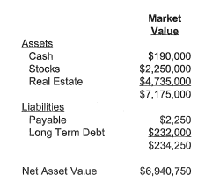
Valuation Example¹
Cash is invested in money market account. Equity investments include stocks and mutual funds that are well diversified. Real estate consists of shopping center and a rent house.
¹Example from Comprehensive Guide for the Valuation of Family Limited Partnerships, 4th Edition, pages 89-105.

Slide 25
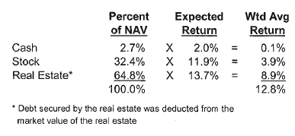

Valuation Example¹
Income Approach – Discount Rate
  Expected Return
    Cash – based on prevailing interest rate of the cash as of the valuation date
    Stock – based on long-term historical average return for large company stocks
    Real Estate – based on long-term average return for REITs
¹Example from Comprehensive Guide for the Valuation of Family Limited Partnerships, 4th Edition, pages 89-105.

Slide 26
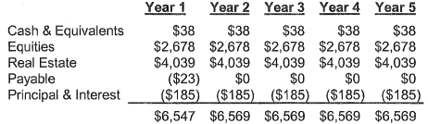
Valuation Example¹
Income Approach – Net Cash Flow Projection
The present value of the forecasted cash flow using a 15.8% discount rate and the mid-year convention is $44,731.
¹Example from Comprehensive Guide for the Valuation of Family Limited Partnerships, 4th Edition, pages 89-105.

Slide 27
Valuation Example¹
Market Approach – Price to Net Asset Value (NAV)
¹Example from Comprehensive Guide for the Valuation of Family Limited Partnerships, 4th Edition, pages 89-105.

Slide 28
Valuation Example¹
Market Approach – Price to Net Asset Value (NAV)
¹Example from Comprehensive Guide for the Valuation of Family Limited Partnerships, 4th Edition, pages 89-105.

Slide 29
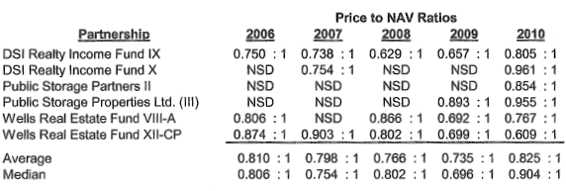
Valuation Example¹
Market Approach – Price to Net Asset Value (NAV)
¹Example from Comprehensive Guide for the Valuation of Family Limited Partnerships, 4th Edition, pages 89-105.

Slide 30
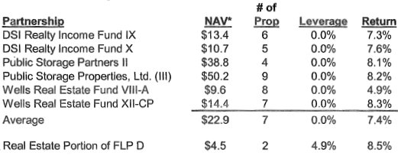
Valuation Example¹
Market Approach – Price to Net Asset Value (NAV)
¹Example from Comprehensive Guide for the Valuation of Family Limited Partnerships, 4th Edition, pages 89-105.

Slide 31
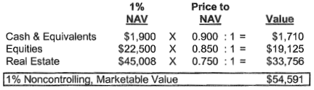
Valuation Example¹
Market Approach – Price to Net Asset Value (NAV)
¹Example from Comprehensive Guide for the Valuation of Family Limited Partnerships, 4th Edition, pages 89-105.

Slide 32
Valuation Example¹
Reconciliation of Approaches
Income Approach - $44,731
Market Approach - $54,591
¹Example from Comprehensive Guide for the Valuation of Family Limited Partnerships, 4th Edition, pages 89-105.

Slide 33
Valuation Report
The valuation report for FLLC/FLPs should be very similar to an operating company valuation report. Two items of note:
  Should contain detailed description of the operating/partnership agreement
  Economic and industry analysis should provide an overview of the general US economy, capital markets and specific analysis of the industry in which the primary assets of the entity are held

Slide 34
Questions?

