Slide 1
2022 ECONOMIC OUTLOOK
AND FINANCIAL MARKET UPDATE
January 2022
Scott Colbert, CFA
Executive Vice President
Director of Fixed Income & Chief Economist
scott.colbert@commercebank.com

Slide 2
THE ECONOMY TODAY – A SHARP REBOUND SLOWS
GROWTH
  By mid year 2021, US GDP had fully recovered from last year’s recession and was above its pre-pandemic level. Fiscal stimulus, zero percent monetary policy, an infrastructure package and a positive vaccination response continue to drive our recovery forward but at a more modest pace against the recent wave like surge of the COVID variants (Delta and the new Omicron). We have lowered our projected growth over the second half of the year given the global COVID rebound and the ongoing supply chain disruptions that have yet to clear. Third quarter growth was a modestly positive 2.2%, with a stronger fourth quarter well underway. Still, second half growth will be down from the first half’s growth rate of 6.5%. Full year 2021 GDP should range from 5.5% to 5.7%.
JOBS
  Unemployment peaked a year ago at a post depression high of 14.7% and has quickly fallen to 4.2% in November. While the strong rebound in employment slowed in August and September (primarily due to the rebound in Covid cases), employment accelerated in September and October. We expect unemployment to continue decline with job openings as measured by the JOLTS, NFIB and Manpower survey at near record levels. Help wanted is this recovery’s mantra and will be the driving force that transitions our current stimulus led/cyclical re-opening growth towards a longer term self-sustaining economic recovery.
INTEREST RATES
  Monetary policy remains in hyperdrive, but strong growth and accelerating inflation have begun to push interest rates higher. This is likely to pull forward an unwind to quantitative easing and an eventual boost to short term interest rates. In addition, bond credit spreads remain exceptionally low. While long term interest rates have fallen somewhat from this year’s March highs, a further reduction in the “output gap”, and rising inflation (CPI last month was 6.8%, a 39 year high) will likely continue to put upward pressure on short term interest rates and hurt bond market returns. We think investors should have shorter maturities and more credit exposure (higher yields) than typical.
MARKETS
  Despite last year’s recession, the S&P 500 finished up 18% in 2020. This year it has added nearly another 25% through mid December, although volatility has spiked up recently as the Omicron variant and a more assertive Fed have provided the markets reason to pause. In addition, there has been a tremendous amount of back-and-forth factor rotation between growth, value and quality all year as well as an ongoing correction in small cap stocks. Essentially breadth has narrowed considerably into those FANG type names and that generally ends with a correction of some sort. Developed international markets are also up a solid 10% but still lag US returns, while deeply negative Chinese equity returns have held emerging market stock indexes at close to a zero total return for the year. We remain one third underweight international asset targets but are actively looking for pockets of overseas value.
OUTLOOK
  After this year’s surge in stock prices, we reduced equity exposure back toward our normal targets over the third quarter. We remain underweight bonds while recommending some high yield exposure. The underweight in our bond allocation has been directed toward a boost in our hedged equity allocation. We continue to emphasize domestic mid cap stocks and are underweight international markets. With US earnings still growing, we remain committed to risk-based assets, although our models suggested domestic stocks are very expensive unless viewed relative to the bond market. While we expect some pause in this upward equity trend, positive year end seasonals and growing earnings are helping keep stocks elevated at record levels. We find it extremely difficult to recommend adding to bond positions yet, despite the recent modest move higher in rates.
Source: Commerce Trust Company
2

Slide 3
GLOBAL GROWTH COLLAPSED IN 2020
(AND HAS REBOUNDED MUCH QUICKER THIS YEAR)
Source: International Monetary Fund, World Bank
*Projections based on average of both sources
3

Slide 4
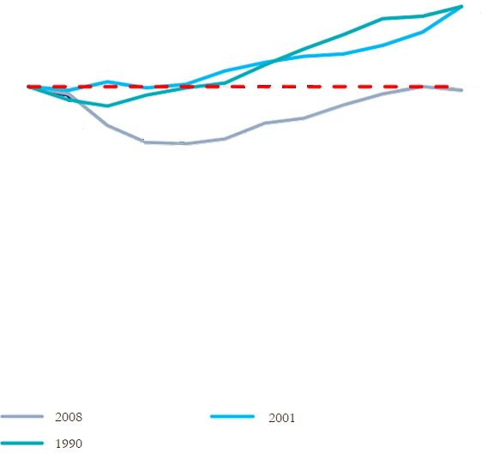
U.S. GDP PLUNGED, BUT WILL RECOVER MORE QUICKLY THAN ANTICIPATED (MUCH FASTER THAN THE LAST THREE RECESSIONS)
1.15
1.10
1.05
1.00
0.95
0.90
4% Growth in 2022
Current Expansion
5.5% Growth in 2021
1990 and 2001 Recessions
2008 Subprime
Recession
Q4 ’19 | Q1 ’20 | Q2 ’20 | Q3 ’20 | Q4 ‘20 | Q1 ’21 | Q2 ’21 | Q3 ’21 | Q4 ‘21 | Q1 ’22 | Q2 ’22 | Q3 ’22
2021 - 2022 GDP Projections
Source: Citi Research, Commerce Trust Company
4
Notes:
1.085
1.045

Slide 5
OFFICIAL UNEMPLOYMENT RATE
(LOWER THAN NORMAL DUE TO SHRINKAGE OF OUR WORKFORCE)
Pre-Pandemic
Average: 6.2%
High: 10.8%
Low: 3.5%
April 2020 Unemployment 14.7%
Unemployment Rate (%)
November Unemployment 4.2%
Note: 152.5 Million Jobs In February 2020
148.6 Million Jobs In November 2021
Source: Bloomberg
5

Slide 6
TOTAL NON-FARM EMPLOYMENT
(LARGE GAP STILL TO FILL)
February 2020 Peak Employment 152.5 Million
Current
Employment
148.6 Million
Employment Rate (Millions)
April 2020 Unemployment Bottom 130.2 Million
Source: Bloomberg
6

Slide 7
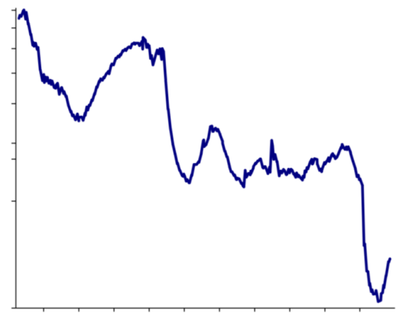
GLOBAL SHORT RATES – COLLAPSED, BOTTOMED, AND NOW MOVING HIGHER
6.0
5.2
4.5
GLOBAL SHORT RATES
MAR. 16: | 1.12%
APR. 17: | 0.93%
MAY 18: | 0.84%
JUNE 18: | 0.75%
AUG. 20: | 0.68%
SEP. 21: | 0.67%
NOV. 6: | 0.68%
DEC. 3: | 0.69%
JAN. 14: | 0.63%
FEB 18: | 0.64%
MAR 25: | 0.68%
MAY 19: | 0.71%
JUN 25: | 0.77%
SEP 17: | 0.88%
3.7
2.9
2.1
1.9
1.4
0.6
 | 02 | 04 | 06 | 08 | 10 | 12 | 14 | 16 | 18 | 20
Source: Evercore ISI
7

Slide 8
CONSUMER – REMAINS IN BETTER SHAPE THAN YOU KNOW
Debt Service Ratio (Left)
Debt-to-Income Ratio (Right)
7.3%
Source: Bloomberg, FRB, BEA, Goldman Sachs Global Investment Research, Baird

Slide 9
HOUSING MARKET STILL EXCEPTIONALLY STRONG
Source: Bloomberg, Baird

Slide 10
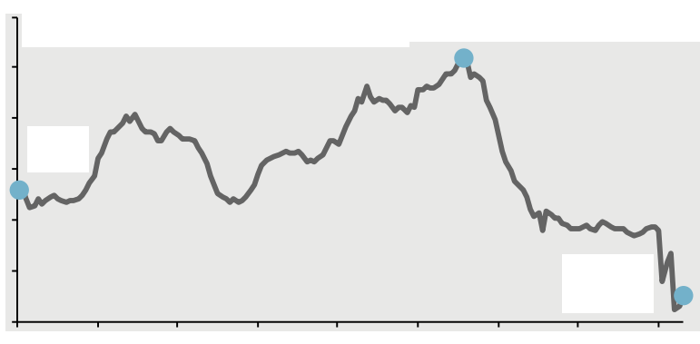
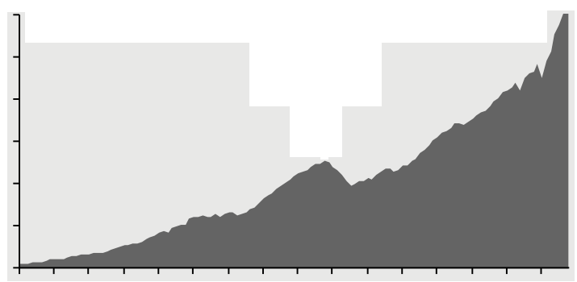
CONSUMER FINANCES – LARGE POSITIVE WEALTH EFFECT
Consumer Balance Sheet
2Q21, Trillions of Dollars Outstanding, Not Seasonally Adjusted
Household Debt Service Ratio
Debt Payments as % of Disposable Personal Income, SA
14%
13%
12%
11%
10%
9%
8%
4Q07:
13.2%
Total Assets: $159.3tn
3Q07 Peak: $85.1tn
1Q09 Low: $73.9tn
1Q80:
10.6%
3Q21**:
8.5%
’80 | ’85 | ’90 | ’95 | ’00 | ’05 | ’10 | ‘15 | ‘20
Household Net Worth
Not Seasonally Adjusted, USD Billions
$140,000
$120,000
$100,000
$80,000
$60,000
$40,000
$20,000
3Q21**:
$144,564
3Q07:
$70,730
Total Liabilities: $17.7tn
Source: FactSet, FRB, JP Morgan, BEA
*Revolving includes credit cards
’90 | ’92 | ’94 | ’96 | ’98 | ’00 | ’02 | ‘04 | ’08 | ’10 | ’12 | ‘14 | ‘16 | ‘18 | ‘20
**3Q21 figures for debt service ratio and household net worth are J.P. Morgan Asset Management estimates.
10

Slide 11
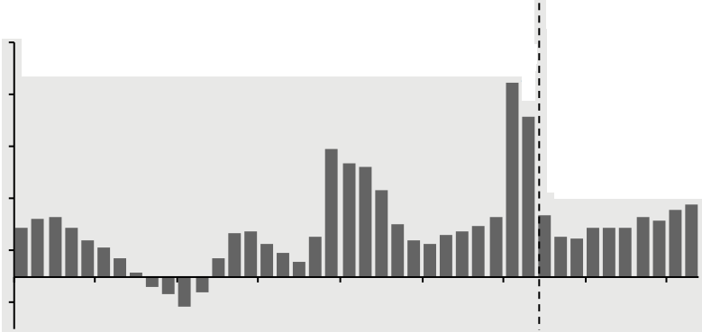
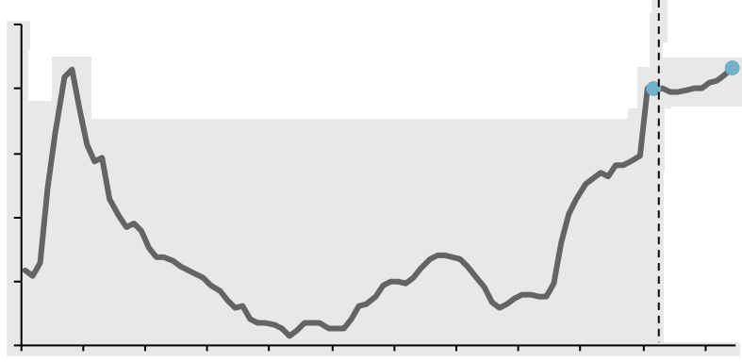
LIMITATIONS ON FISCAL POLICY
The 2022 Federal Budget,
CBO Baseline Forecast, USD Trillions
Federal Budget Surplus/Deficit
Forecast
% of GDP, 1990-2031, CBO Baseline Forecast
2021:
-12.3%
-18%
-14%
-10%
-6%
-2%
2%
Total Spending: $5.5tn
2031:
-5.5%
2022:
-4.7%
’90 | ’95 | ’00 | ’05 | ’10 | ’15 | ’20 | ’25 | ’30
Federal Net Debt (accumulated deficits)
% of GDP, 1940-2031, CBO Baseline, End of Fiscal Year
120%
100%
80%
60%
40%
20%
2021:
99.7%
2031:
106.4%
Forecast
’40 | ’48 | ’56 | ’64 | ’72 | ’80 | ’88 | ’96 | ’04 | ’12 | ’20 | ‘28
Source: JP Morgan, CBO, BEA, Treasury Dept
11

Slide 12
CORPORATE CREDIT SPREADS – 1/31/97 through 11/30/21
Option Adjusted Spread (Basis Points)
367
103
High Yield Index Average 549 bps
Investment Grade Corporate Average 153 bps
Source: BBG Barclays, ICE BofA ML
12
Notes:
12

Slide 13
INFLATION – AGGRESSIVELY TURNING UP
6.8%
Source: Bloomberg
13

Slide 14
WAGE GROWTH AND CORE PCE
WAGE GROWTH
% CHANGE (CORE PCE)
% CHANGE (WAGES)
CORE PCE
Source: Bloomberg
14
Notes:
Add lines and colors

Slide 15
OWNER’S EQUIVALENT RENT LAGS HOME PRICES AND FORWARD RENTS
PERCENT CHANGE YOY
OWNER’S EQUIVALENT RENT
APARTMENT REAL ESTATE
EFFECTIVE RENT
Source: Bloomberg
15
Notes:
Add lines and colors

Slide 16
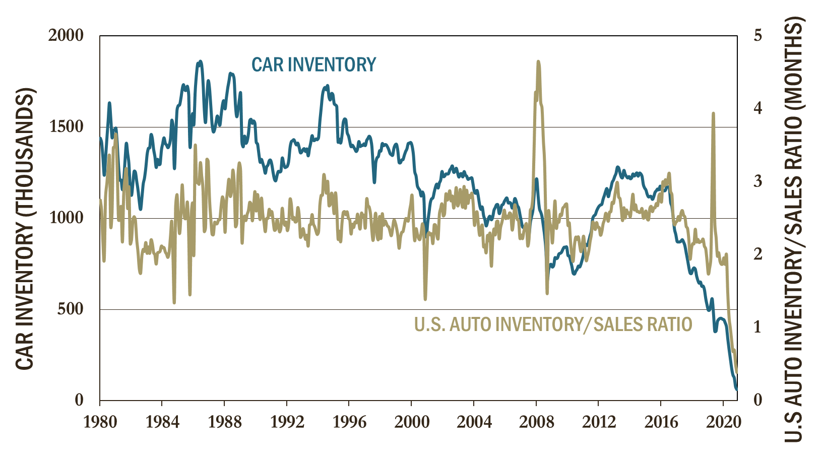
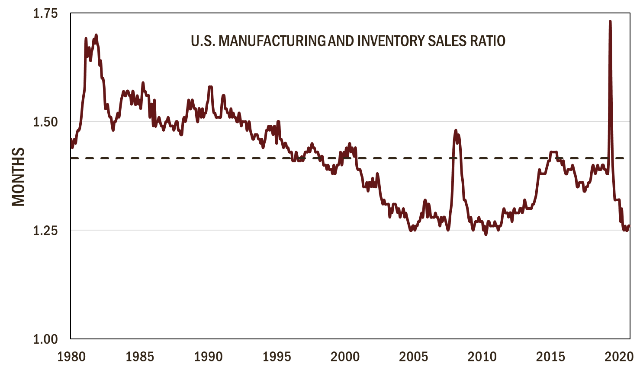
INVENTORIES AT ALL TIME LOWS
U.S. car inventory has declined by more than 90% to 125,000 light vehicles
The auto inventory to sales ratio is at an all time low
Total U.S. manufacturing inventory to sales ratio is also at an all time low
Source: Bloomberg
16
Notes:
Pasted as pictures
Average of the inventory sales ratio
Left hand side label months
Add lines and colors

Slide 17
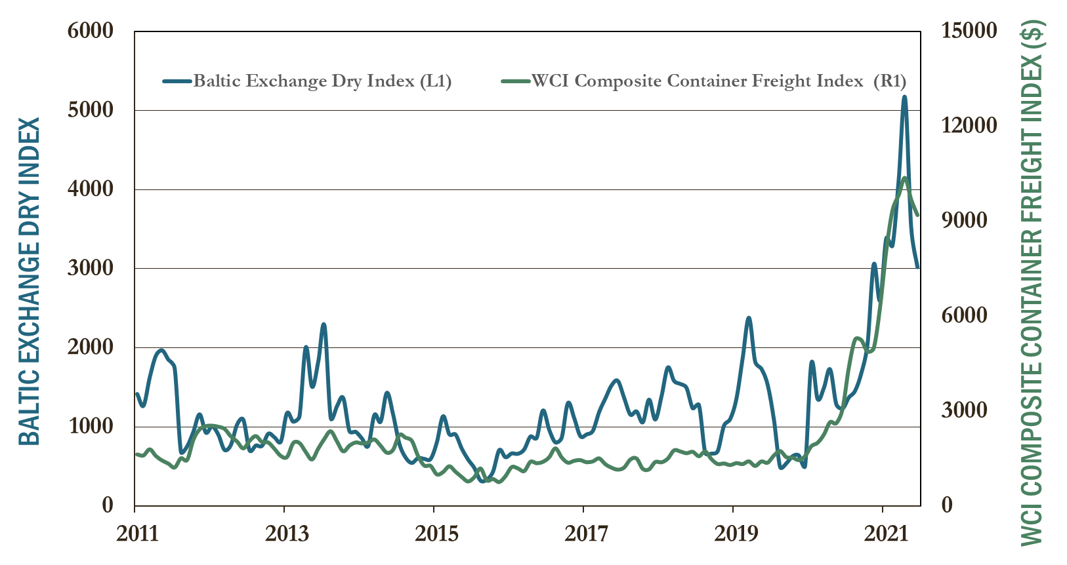
TRANSPORTATION COSTS AT ALL TIME HIGHS
The Baltic dry freight index, a measure of what it costs to ship bulk goods like iron ore and grains overseas, is up more than 7 times pre- pandemic levels.
The 25 million boxes shuttling around the globe on approximately 6000 ships cost three times more on average to rent today versus their pre-pandemic level driven up mostly by rising prices from Asian market deliveries to North America.
PRODUCER PRICE INDEX GENERAL FREIGHT TRUCKING INDEX
YEAR OVER YEAR
Transportation bottlenecks and driver shortages point to continued supply pressure.
Source: Bloomberg
17
Notes:
ADD $$$ TO WCI INDEX

Slide 18
INFLATION HAS FALLEN SEQUENTIALLY PER EXPANSION (BUT NOT THIS TIME)
REAGAN
10/31/82 – 08/31/90
Avg: 4.1%
% CORE PCE YOY
CURRENT EXPANSION
Avg. 2.3%
BUSH
10/31/01 – 11/30/07
Avg. 1.9%
OBAMA/TRUMP
06/30/09 – 1/31/2020
Avg. 1.6%
BUSH/CLINTON
03/31/91 – 02/28/01
Avg. 2.1%
Source: Bloomberg
Number of Months
18

Slide 19
YOU THINK OUR INTEREST RATES ARE LOW?
Source: Bloomberg
19

Slide 20
QUANTITATIVE EASING AS A PERCENT OF GDP
136.1
JAPAN
% OF GDP
EUROPEAN UNION
69.8
59.5
G4
42.1
38.2
UNITED STATES
GREAT BRITAIN
Source: Bloomberg
20

Slide 21
U.S. CORONAVIRUS VS. VACCINES
COVID-19 U.S. VACCINE STATS
Weekly Average U.S. Doses Per Day | 1,380,000
Source: Bloomberg
21
Notes:
COVID 19 Vaccine Stats – email Scott’s BBG email
More Than 3.54 Billion Shots Given: Covid-19 Vaccine Tracker
2021-07-15 19:35:59.696 GMT
https://www.bloomberg.com/graphics/covid-vaccine-tracker-global-distribution/
PageExcerpt:
By Tom Randall, Cedric Sam, Andre Tartar, Paul Murray and
Christopher Cannon
(Bloomberg) -- For the full experience visit: <a href="https://www.bloomberg.com/graphics/covid-vaccine-tracker-global-distribution/?terminal=1">More ...
To view this story in Bloomberg click here:
https://blinks.bloomberg.com/news/stories/QWAX3ZT0AFB8

Slide 22
GLOBAL CORONAVIRUS VS. VACCINES – FOURTH WAVE
COVID-19 GLOBAL VACCINE STATS
Weekly Average Global Doses Per Day | 37,200,000
Source: Bloomberg
22
Notes:
COVID 19 Vaccine Stats – email Scott’s BBG email
More Than 3.54 Billion Shots Given: Covid-19 Vaccine Tracker
2021-07-15 19:35:59.696 GMT
https://www.bloomberg.com/graphics/covid-vaccine-tracker-global-distribution/
PageExcerpt:
By Tom Randall, Cedric Sam, Andre Tartar, Paul Murray and
Christopher Cannon
(Bloomberg) -- For the full experience visit: <a href="https://www.bloomberg.com/graphics/covid-vaccine-tracker-global-distribution/?terminal=1">More ...
To view this story in Bloomberg click here:
https://blinks.bloomberg.com/news/stories/QWAX3ZT0AFB8

Slide 23
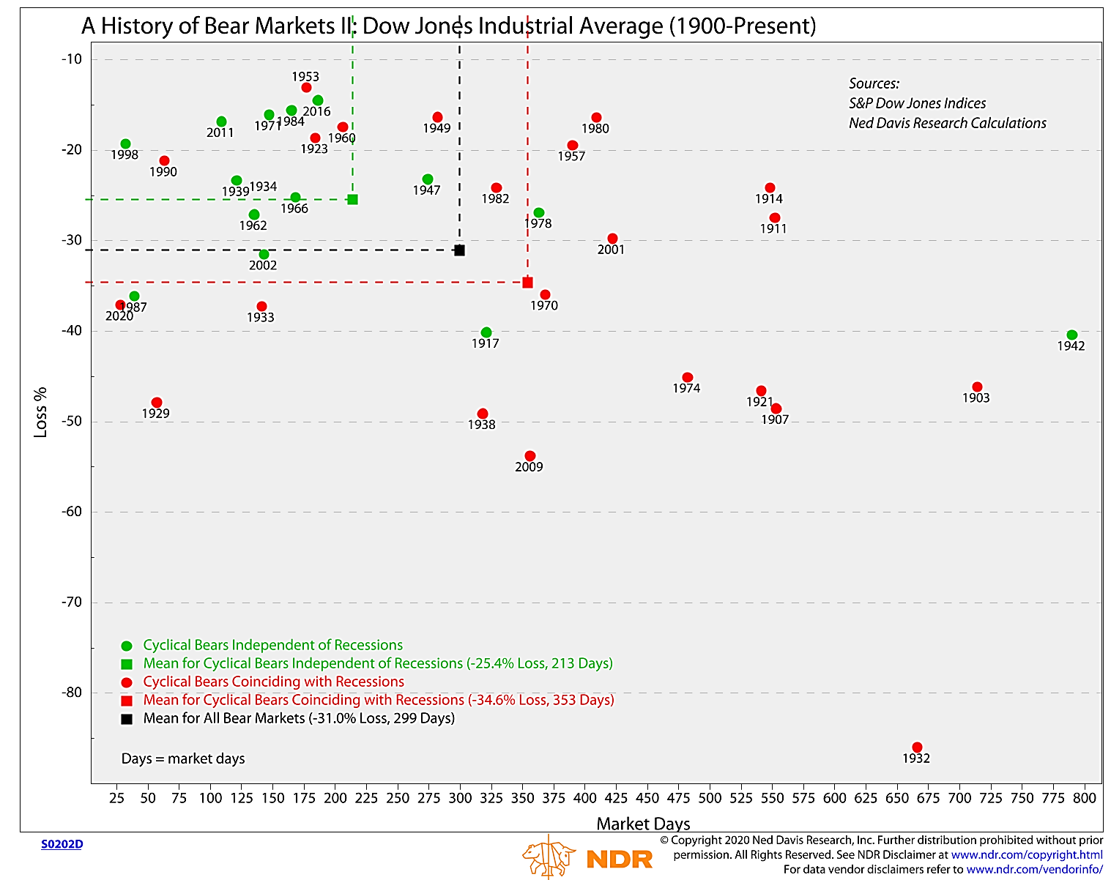
A HISTORY OF BEAR MARKETS
DOW JONES INDUSTRIAL AVERAGE (1900 – PRESENT)
23

Slide 24
YTD EQUITY RETURNS (MARKET ROTATES AND BROADENS) as of 11/30/2021
Source: Bloomberg
24

Slide 25
YTD INDEX RETURNS as of 11/30/2021
Source: Bloomberg
25

Slide 26
BBG BARCLAYS US AGGREGATE BOND TOTAL RETURNS
(10 YEARS FORWARD PROJECTION)
BBG BARC US AGG BOND TOTAL RETURN 10 YRS FWD
10 YEAR FORWARD TOTAL RETURN
2.31% Projected 10 Year Return (as of 10/20/2021)
CURRENT 10 YEAR GOVERNMENT BOND YIELD
26

Slide 27
S&P 500 INDEX 10-YEAR SUBSEQUENT ANNUALIZED RETURN (%) (BASED ON CURRENT P/E – 1980-2020)
S&P 500 TOTAL RETURN 10 YRS FWD
2020 YEAR END P/E
38
2021 YEAR END FORWARD P/E
10 YEAR FORWARD TOTAL RETURN
CURRENT P/E (REPORTED CONTEMPORANEOUS) (WINSORIZED: DATA FROM 9/30/2008 THROUGH 6/30/2009 REMOVED)
27
Notes:
Time period from Bill

Slide 28
S&P 500 INDEX 10-YEAR SUBSEQUENT ANNUALIZED RETURN (%) (BASED ON CAPE P/E)
Historic P/E Multiple vs. subsequent decade’s return
1/1/1946 – 08/31/2011
CAPE
P/E
CAPE PE as of 8/31/21:
37.4x
13 historic instances of P/E’s from
35.4x to 39.4x with returns that ranged
from a low of -1.4% (December 1998) to a high of 4.7% ( August 1998)
The average of the 13 historic instances was 2.0%. The projected return based on the current CAPE PE is 0.4%
RETURNS (%)
PROJECTED REGRESSION RETURN
Calculations based on IA SBBI US Large Stock TR USD and Cyclically Adjusted Price Earnings Ratio for S&P Composite
Source: Ibbotson, Robert Shiller
*CAPE PE is the cyclically adjusted P/E ratio for the S&P Composite.
Dark Brown Diamonds represent the data points from January 1999 through December 2000.
28

Slide 29
S&P 500 REAL EARNINGS GROWTH AND
10-YEAR MOVING AVERAGE
Current annualized earning per share $208
$ EARNINGS PER S&P 500 SHARE
159.50
116.54
Source: Schiller Data
29
Notes:
$ earnings per S&P 500 Share (LHS)
Current annualized earning per share $208
Get update from Chris Holmes

Slide 30
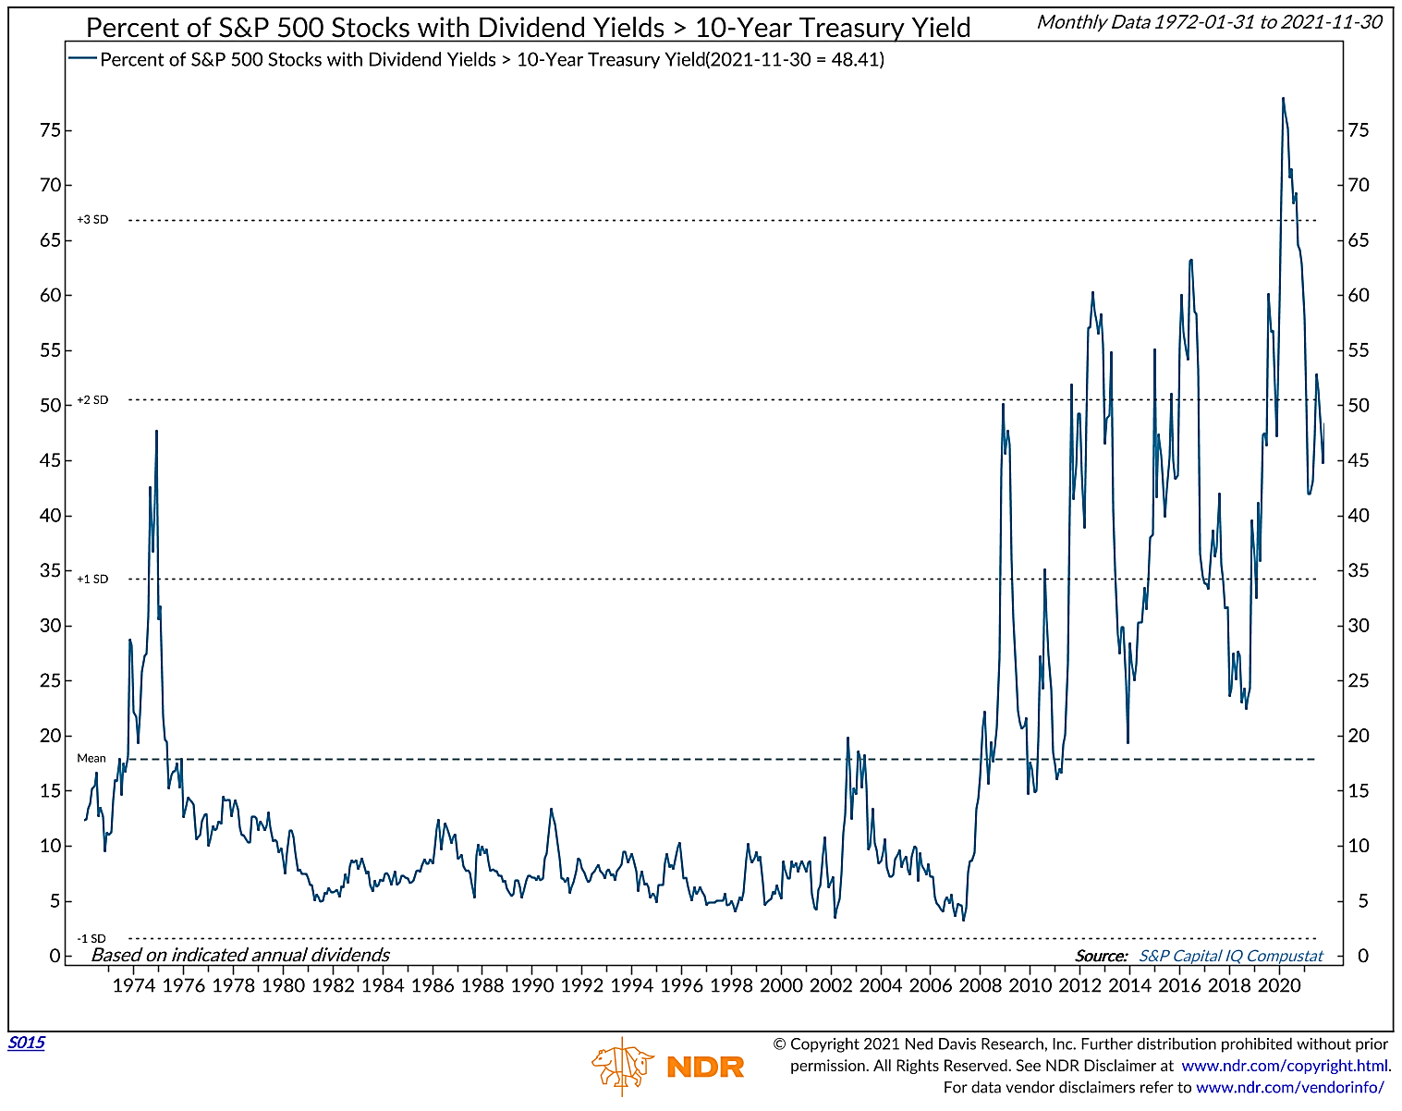
PERCENT OF STOCKS WITH DIVIDENDS HIGHER THAN 10-YR TREASURY
30

Slide 31
YIELD IMPACT ON P/E MULTIPLE
(VALUATION WILL COMPRESS)
TEN YEAR TREASURY RATE VS. CYCLICALLY-ADJUSTED P/E MULTIPLE
1/1/1955 – 11/30/2020
INTEREST RATE | P/E
CURRENT | 31.3
2% | 27
3% | 24.5
4% | 22.5
24
Calculations based on Cyclically Adjusted Price Earnings Ratio for S&P Composite
Source: Ibbotson, Robert Shiller & Federal Reserve Economic Database
*CAPE is the cyclically adjusted P/E ratio for the S&P Composite.
Green dots represent the data points from January 1999 through December 2000.
31
Notes:
31

Slide 32
POST RECESSION STOCK MARKET RETURNS DURING ECONOMIC RECOVERIES
RECESSION START | RECESSION END | RECESSION MONTHS | RECOVERY DURATION MONTHS | STOCK MARKET RECESSION BOTTOM | STOCK MARKET RECESSION RECOVERY PEAK | RECOVERING MARKET DURATION MONTHS | RETURN | ANNUALIZED RETURN
APR-60 | FEB-61 | 10 | 105 | NOV-60 | DEC-68 | 97 | 162% | 12.7%
DEC-69 | NOV-70 | 11 | 36 | JUL-70 | JAN-73 | 30 | 75% | 25.2%
NOV-73 | MAR-75 | 16 | 70 | OCT-74 | JAN-80 | 74 | 198% | 19.4%
JUL-80 | NOV-82* | 28 | 92 | AUG-82 | JUL-90 | 95 | 355% | 21.1%
JUL-90 | MAR-91 | 8 | 120 | OCT-90 | SEP-00 | 119 | 525% | 20.5%
MAR-01 | NOV-01 | 8 | 73 | OCT-02 | NOV-07 | 61 | 108% | 15.2%
DEC-07 | JUN-09 | 18 | 128 | MAR-09 | FEB-20 | 131 | 450% | 16.9%
FEB-20 | APR-20 | 2 | 17 | MAR-20 | ? | 18 | 110%** | ?
AVERAGE |  | 13 | 89 |  |  | 87 | 248%*** | 18.7%
*Combined both the 1980 and 1981 recessions
** Recovery and returns as of 11/30/2021
***Standard Deviation = 172%
Source: Commerce Trust Company
32
Notes:
SPX start date 3/23/2020

Slide 33
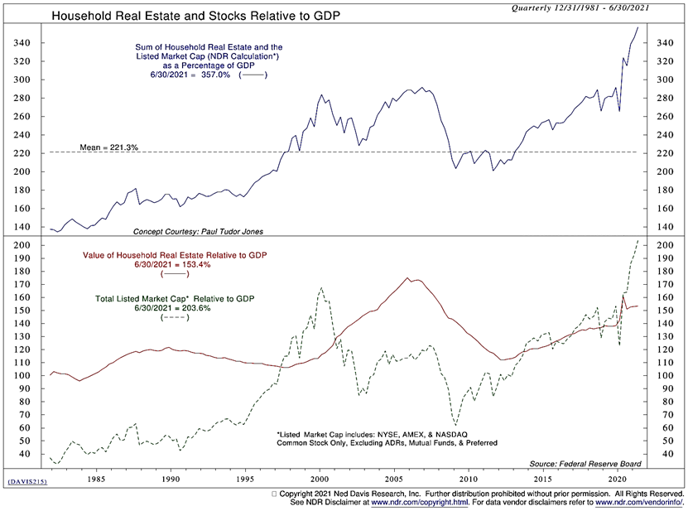
HOUSING AND STOCKS VS. GDP (EXPENSIVE)
Bubble?
Internet
Bubble
Housing
Bubble
Both?
Equity Peak
Housing Peak
33

Slide 34
FORECAST AND PORTFOLIO BIASES
INTEREST RATES WILL CONTINUE TO RISE, AND BOND RETURNS COULD BE NEGATIVE FOR BOTH TAXABLE AND THE VERY RICH MUNI MARKET
  We have shortened our durational target to 85% to 90% of the portfolio’s benchmark.
SLIGHTLY FAVOR RISK ASSETS IN GENERAL
  We are underweight our fixed income targets, neutral on equities and have an allocation in the alternative sectors
HIGH YIELD OUTPERFORMS INVESTMENT GRADE TAXABLE BONDS
  Move down in credit favoring (in this priority): Bank Loans, Corporates, Preferreds, and Emerging Market debt.
DOMESTIC STOCKS SHOULD CONTINUE TO OUTPERFORM INTERNATIONAL MARKETS
  We are one-third underweight our International targets and expect the dollar to remain relatively firm
MID CAP STOCKS WILL OUTPERFORM BOTH LARGE CAP AND SMALL CAP STOCKS
  We prefer the higher profitability and stronger balance sheets of Mid Cap vs. Small Cap.
WE HAVE REDUCED GROWTH EXPOSURE AND ARE EVENLY SPLIT BETWEEN GROWTH AND VALUE.
  Anticipation of the re-opening of the economy should produce a period of Value outperformance. Structurally, we still like Growth longer-term.
WE ARE OVERWEIGHT INTERNATIONAL DEVELOPED EQUITY VERSUS EMERGING MARKET
  70% of our International allocation is in Developed Equity
HIGHEST CONVICTION
LOWEST CONVICTION

