Slide 1
Title research in Indian country
Jennifer E. Krieg
VP Land & General Counsel
jkrieg@rsenergysolutions.com 405.286.9326

Slide 2
Indian TRIBEs OF Oklahoma
Five Tribes
BIA Eastern Oklahoma Regional Office
Cherokee Nation
Choctaw Nation of Oklahoma
Mississippi-Choctaw
Seminole Nation of Oklahoma
The Chickasaw Nation
Muscogee (Creek) Nation

Slide 3
FIVE tribes of oklahoma

Slide 4
Indian TRIBEs OF Oklahoma
Western Tribes
BIA Anadarko Regional Office
Concho Agency
Cheyenne-Arapaho Tribes
Anadarko Agency
Apache
Caddo
Wichita
Kiowa
Comanche
Ft. Sill Apache

Slide 5
Indian TRIBEs OF Oklahoma
Western Tribes
BIA Anadarko Regional Office
Pawnee Agency
Pawnee
Ponca
Tonkawa
Otoe-Missouria
Shawnee Field Office
Kickapoo
Absentee Shawnee
Pottawatomie
Sac & Fox

Slide 6
Western Tribes

Slide 7
Western Tribes

Slide 8
Indian TRIBEs OF Oklahoma
Osage Nation
BIA Pawhuska Agency
Osage Mineral Council

Slide 9
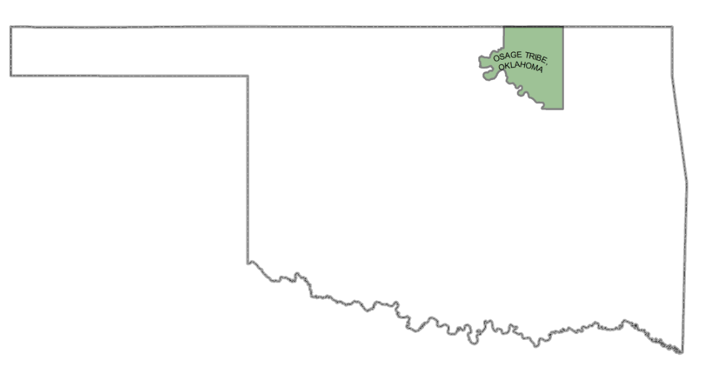
Osage Tribe

Slide 10
History – five Tribes
The Dawes Commission
1893: Established Dawes Commission
1896: Directed Commission to take a census and prepare tribal rolls;
1897: Curtis Bill which established a comprehensive plan for dissolution of the tribal governments and allotment of tribal lands; patents issued in fee restricted status;
May 28, 1908 Restrictions Bill
Removed all restrictions from all lands including homesteads
Intermarried citizens
Freedmen
Tribal citizens with less than half blood, including minors
removed restrictions from all lands except homesteads, of citizens of more than half and less than three-quarters blood
retained restrictions on surplus and homesteads of all three-quarters and full-bloods
Retained restrictions on homesteads of persons, including minors with more than half blood and all full-bloods until April 26, 1931;

Slide 11
History – five Tribes
1934 Indian Reorganization Act
Extended the trust period on restricted allotments until further legislation;
Act of August 4, 1947 – Stigler Act
Codifies process for which oil & gas leases and deeds executed by restricted heirs and successors of allottee are approved by district court;

Slide 12
Title Research five tribes – Restricted title traps
Record title is in the county land records;
Generally, title will start with patents or with restricted form deeds;
Creek & Choctaw nations you can request a title report; However, not all tracts have been completed and those that are only as up to date as probated estates;
Heirs and successors of the original allottee who are ½ blood or more the Five Tribes remain restricted;
Orders approving leases or deeds are NOT proof of title;
See Appendix A
Owner can also request a Removal of Restrictions from the BIA; these can be conditional, site specific or a ‘55 removal;
Once restriction is lost, it is not recovered; See Appendix B
An heir can hold a restricted interest and an unrestricted interest;

Slide 13
Title Research five tribes – Civilized Minors/Incompetents
Civilized minors/incompetents owning restricted acreage must have guardians appointed to execute oil and gas leases;
Guardianship proceedings must be held pursuant to the Oklahoma Guardianship Act which provides for notice to BIA, Office of the Tulsa Field Solicitor and tribes;
Proceedings must be held in county of residency AND county in which tract lies;
Yearly reports to the Court are required;
Executed power of attorney documents are invalid as to restricted property;

Slide 14
Title Research five tribes – Restricted title traps
Everyone believes they are full blood – check CBID cards and ask follow-up questions;
Watch for unapproved deeds of restricted heirs;
Assignments listing BIA lease numbers;
Invalid probates due to lack of notice to BIA or judge’s approval;
There is always more than one Alex Harjo!!!

Slide 15
Title Research five tribes – Trust Tracts
Trust
Tracts are administered by the Eastern Oklahoma Regional Office in Muskogee;
Agency maintains title on trust lands; and will provide a Title Status Report See Appendix C
Leases are at 3/16th royalty and are a three year term.
Leases contain no pooling or spacing language – require a Communization Agreement – an agreement must be filed ninety (90) days prior to expiration; See Appendix D
Leases are subject to all regulations contained in 25 CFR 213;
Leases which you drill on or thru are subject to all federal environmental regulations – Clean Air Act, National Historic Preservation Act and National Environmental Protection Act; An Application for Permit to Drill must be submitted to the Bureau of Land Management – approval time of RSES APDs is currently six to eight months;

Slide 16
Title Research History – Western Tribes
The General Allotment Act of 1887
Unlike the restricted fee ownership allotment scheme of the Five Civilized Tribes, Indian allotments under this act were made on the basis of trust-type ownership; legal title remains in the federal government and does not pass to the allottee or his heirs until the issuance of a fee patent;
The 1938 Omnibus Leasing Act
Basic authority for leasing tribal lands;
25 CFR 212
Leasing of Allotted Lands for Mineral Development

Slide 17
Title Research Western Indians
Anadarko, Concho & Pawnee Agencies hold lease sales at their own discretion
Leases are for a three (3) year term and a 1/5 royalty rate; See Appendix E
Successful bidder is only given the right to negotiate with owners – they can demand a higher offer; must meet fair market appraisal;
Agency will provide a title and will provide a Title Status Report; See Appendix F
Expiration is from date of approval by Superintendent;
Probates are completed in CFR courts; district court probates are invalid as to trust property;

Slide 18
Title Research Western Indians
Leases contain no pooling or spacing language – require a Communization Agreement – an agreement must be filed ninety (90) days prior to expiration;
Leases which you drill on or thru are subject to all federal environmental regulations – Clean Air Act, National Historic Preservation Act and National Environmental Protection Act; An Application for Permit to Drill must be submitted to the Bureau of Land Management – approval time is for RSES APDs is six to eight months;
Once a CFR probate is completed, a fee patent will be issued to non-Indian heir; they may often appear as a stranger to title;
Leases are NOT required to be recorded in the courthouse;

Slide 19
Title Research Western Indians
BIA lease forms executed after 1983 contain a non-producing release clause – the only formations held are those which are communitized and producing at the end of primary term;
This clause may also be present in the Communitization Agreement thereby amending older lease forms
Operators should check that they have rights to their target formation. Otherwise, this could result in a trespass.
BIA does not recognize courthouse assignments;
No depth severances, wellbore assignments or ORRI
Accept the fact that BIA title will often not match courthouse title;
Leases are assigned on BIA lease forms;

Slide 20
Recent Developments
Miles v. Southern Plain Regional Director, BIA, 63 IBIA 55 (05/04/2016) related Board case: 60 IBIA 257, vacated and remanded to Board, Cimarex Energy Co. v. Gilbert Miles, No. CIV-15-1163-F (W.D. Okla. 2016)
Case currently pending before the Interior Board of Indian Appeals; at issue is the approval of a timely filed communization agreement after the expiration of the primary term;
Murphy v. Royal, 866 F.3d 1164 (10th Cir. 2017)
Tenth Circuit held that the allotted Muscogee (Creek) Nation reservation has not been disestablished, reversing State death penalty conviction of Creek tribal member.
Supreme Court has granted certiorari – Fall 2018 term;
HR 2606 - Amendment to the Act of August 4, 1947 – commonly referred to the Stigler Act See Appendix G
Will eliminate ½ blood requirement; all heirs of original allottee who are of the Five Tribes, will be restricted;
It is unclear how this will effect leases and conveyances taken from presumptive heirs;

